Slide 1

Notes:
Introduction by Dawn –
REPLACE SLIDE/NOTES WITH LATEST VERSION

Slide 2
SITE SELECTION
Criteria/Filters Applied
1 City-Owned
2 Greater than 2.5 Acres
3 No City Parks w/ Restrictions
4 No Utilized City Facilities
5 No Floodplains, Detention Basins
6 No Borders Residential
Notes:
Good evening, Mayor & Councilors. CS with Eng here to present to you the results of the site selection process for the future Animal Welfare Facility. Our Eng Dept was asked to go through the site selection process from the very top and be able to report the results in a very transparent way. So I’ll start with a explanation of that process.
Our site selection process followed a basic system of applying certain criteria to a long list of possible sites, and whittling that list down to a short list. This short list is then ranked and scored to determine the benefits of the remaining sites, and then applying estimated project costs to create a cost to benefit ratio for each site.
You can think of this very simply as sites are removed from the long list because they’re a “hard no” which leaves sites on a short list that are “suitable” for the purpose – and then the short list evaluation determines which site offers the greatest benefit for each dollar spent.
Any questions about this process?
For our efforts on the Animal Welfare site selection, it just so happens that are long list reduction resulted in only suitable site – meaning we did not need to do our shortlist evaluation. And we’ll discuss this again in a later slide.
You have an exhibit in front of you that was attached to the Report. This is four columns of a larger spreadsheet we used to track our process of filtering sites based on our selected criteria.
The criteria we applied include: must be City owned; more than 2.5 Acres, no City Parks with restrictions, no utilized City Facility sites, no significant floodplain impact sites or detention pond sites, and no sites that border a residential area.
<next slide> The long list of sites we considered starts with this first map.

Slide 3
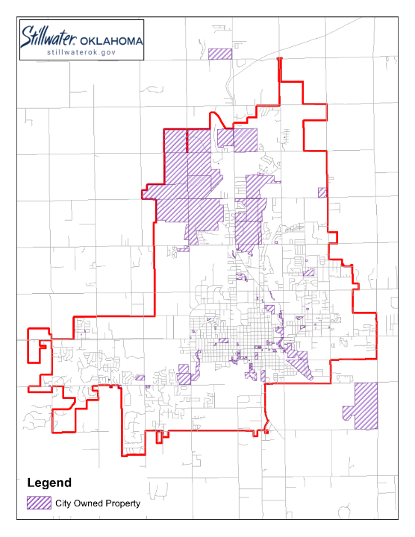
asdf
Map 1
All City-Owned Properties
132 properties
Lake McMurtry land not shown
(Actual City Ownership per Payne Co. is 144 properties.)
Notes:
This first map is where we started in GIS. Per GIS, 132 properties show as City-owned – and those are shown here. Our GIS is not a perfect match for Payne Co. which shows that we own 144. We checked those differences, and the sites missing from our GIS layer would not have survived our criteria filters. So, for the purpose of illustrating our exercise to you, this map shows our long list of 132 properties from GIS.)
McMurtry lies outside of the map area in Noble Co.
ONLY IF Qs are ASKED:
Lake McMurtry’s land is farther west and not shown here; the City owns it.
On your Report, you’ll note that there are two exceptions to City-owned that we considered, but ruled out along the way. (Airport Rd, east of Perkins at the Chamber’s Commerce Park & Highland School frontage on East 6th)
City’s 132 vs PC’s 144:
6th and Western: Payne County Assessor shows 6 properties here while GIS only shows 1. (5)
44th Tower: GIS does not cover land outside City limits, therefore this property was not included. (1)
32nd Ave Booster Pump Station: GIS shows 32nd BPS is owned by Pauline Wright, the assessor shows City of Stillwater. (1)
1414 S Western Rd: GIS shows property is owned by David and Liz Higgins and the assessor shows City of Stillwater. (1)
13th and Walnut: This property is owned by the Housing Authority of The City of Stillwater, which was not included in the GIS query. (0, not counted in 132)
Pleasant Oaks: Assessor shows a strange property owned by the City that GIS doesn’t show. This seems like a drainage easement to my best guess. (1)
Washington School: Assessor shows owned by the City, GIS shows owned by Primeland Properties. (1)
Drainage Area east of Washington School: Assessor shows City ownership, GIS just shows this as Right-of-Way. (1)
Property just south of The Falls subdivision: Assessor shows this property owned by the City, while GIS shows ownership by Rava Ridge LLC. (1)

Slide 4
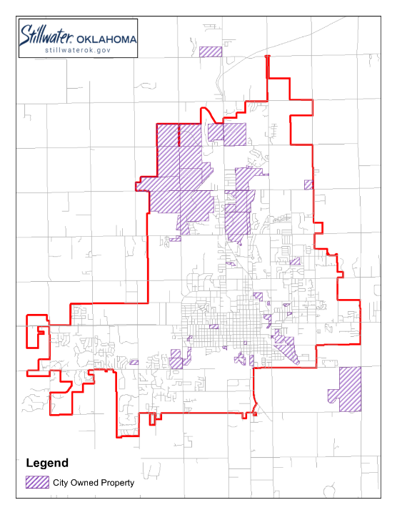
asdf
Map 2
Properties >2.5 acres
47 properties remain
Lake McMurtry not shown
Notes:
Click back and forth to show fewer sites.
The 2nd criterion we applied is based on the architect telling us that the Animal Welfare site layout is a little less than 2.5 acres, so we searched for greater than that area. Those sites are shown here at a count of 47.
We also checked to be sure we weren’t overlooking a slightly smaller site that is shaped perfectly to accommodate the facility, as in between 2 and 2.5 acres; but did not find any.
We also looked at City-owned sites adjacent to each other that could be combined to have a total area of >2.5 acres. We found two cases. The first case is at Pleasant Valley School and the lot directly east, but it has a sewerline passing through the middle of it and it borders residential land. The second case of this is east of City Hall near the railroad, but both parcels of land fall within the floodplain.
If they ask the question:
The red text in the Site Name column is calling attention to the sites considered in the past by the Team as we worked to identify a suitable location.
The blue text is showing the sites sized >2.0 acres and <2.5.

Slide 5
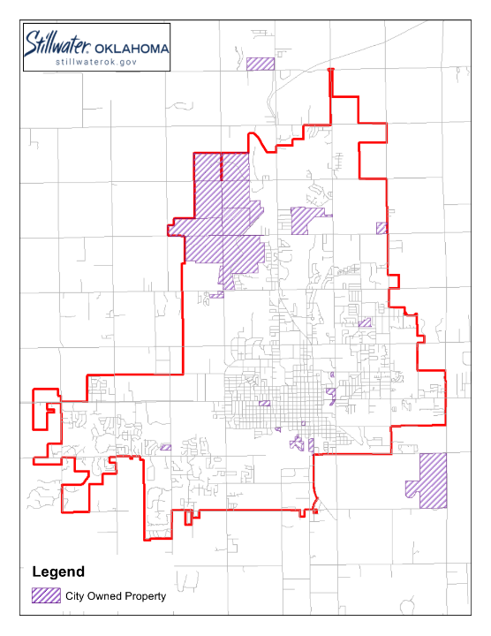
asdf
Map 3
Excluding City Parks w/ restrictions
26 properties remain
Notes:
Click back and forth to show fewer sites.
The 3rd criterion we applied is to remove City Park land with restrictions either through deed limitations or grants. This happens to be many of our parks, and after this criterion was applied, 26 properties remain.
Lake McMurty is removed here. The City’s internal team that helped us identify park restrictions is not aware of certain deed restrictions, per se, related to McMurtry – however, because we condemned the property for a certain use (being a water supply reservoir), we may experience opposition and/or court battles if we chose to use the land for a different use. For this reason, staff eliminated it through this criteria.

Slide 6
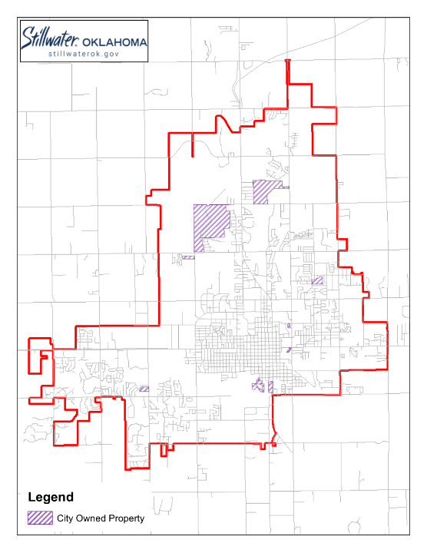
asdf
Map 4
Excluding Utilized City Facilities
10 properties remain
Notes:
Click back and forth to show fewer sites.
For criterion 4, we eliminated any land associated with existing City Facilities or that is planned for city facility in the future.
At this point in the process, we separated the airport property tract where Waste Management is located from the overall Airport Property, knowing that the site east of Waste Management was once considered for other non-Airport uses. This area is identified as “potential development property” on Kellie Reed’s airport maps. So we wanted it to survive this filter and show it here.
After this criterion, 10 properties now remain.
ONLY IF ASKED: This airpot site was eliminated on previous lists for use due the site housing a batch plant; that plant has been removed and the site is now vacant.

Slide 7
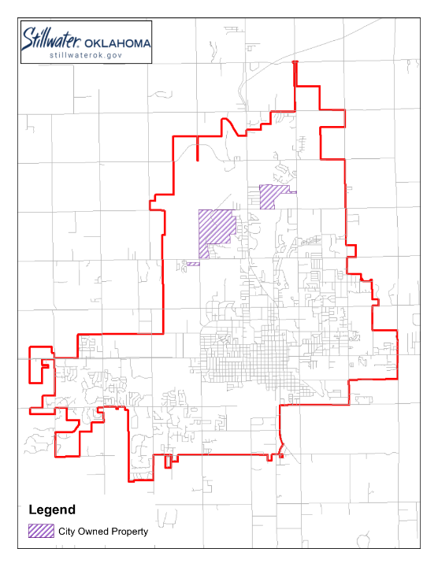
asdf
Map 5
Excluding Floodplain/Detention
3 properties remain
Notes:
Click back and forth to show fewer sites.
The next criterion was to exclude properties that become unusable due to significant floodplain impacts (the kind that can’t be overcome) or sites that are dedicated as detention basins.
This leaves us with 3 properties.

Slide 8
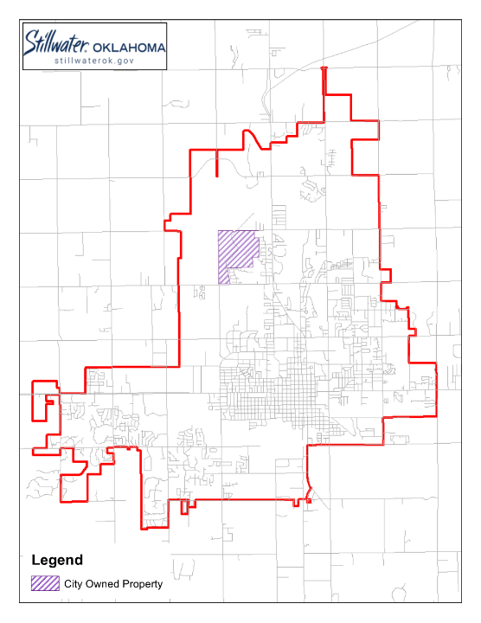
asdf
Map 6
Excluding Borders Residential
1 properties remain
Notes:
The first 5 criteria are common sense criteria… we can’t build on top of City Hall, we can’t build in a detention pond, and we can build on a 1 acre site, for example.
This last criterion is a subjective one and wouldn’t necessarily apply to other selection processes for sites for city facilities. This one removes all sites that border a residential area.
After two sites are removed because they border residential, this map shows a single property remains – the Airport site adjacent to Waste Management.
<next slide>

Slide 9
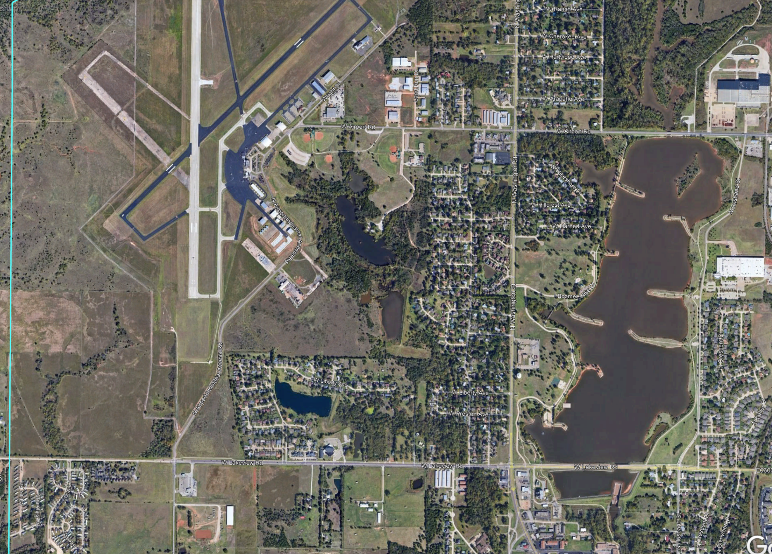
1 – Knoblock/Airport
2 – Airport at Sanborn
3 – Lakeview/Western
1
2
3
Notes:
Going to an aerial image of the sites that remained before this criterion was applied, you can better see where the last 3 sites are located and their proximity to neighborhoods.
Site 1, top right, is the site that was originally selected, Knoblock/Airport.
Site 2, is at the Airport, between Waste Management and Sanborn Lake.
Site 3 is southwest of Lakeview/Western. To avoid the runway protection zone, the facility would need to be built on the west half of this tract.
Sites 1 and 3 both border residential areas.
The southern corner of Site 2 property is about 900-ft north of the residential area to the south and the eastern corner is about 1300-ft west of the residential area to the east.
The general benefits of developing Site 2 compared to the previous selection of Site 1 include:
No compensatory storage needed at Site 2
No clearing needed at Site 2
The distance of the building off of the main road is reduced – meaning less new infrastructure to serve the building.
And - Airport Director Kellie Reed has submitted the appropriate form to FAA for a response on building Animal Welfare here.
This summarize our site selection process.
Next, Dawn will discuss this site and the next steps.

Slide 10
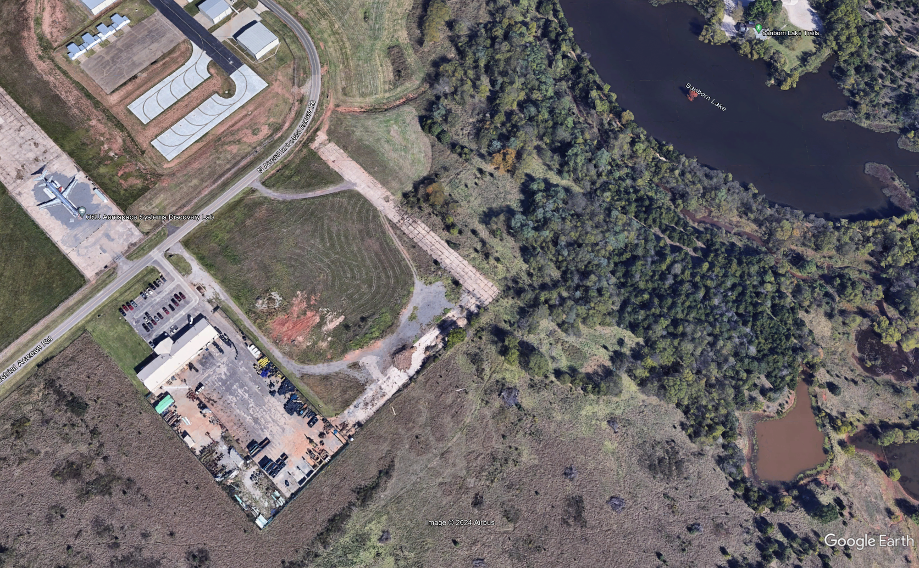
JANUARY 2024

Slide 11

Possibilities at the new site – new Fire Station #2, Hargis Road reroute, Sanborn Lake, walking trails, new airport terminal, and new Ray and Linda Booker OSU Flight Center.
Rachel Wasserman has been in contact with other animal welfares that are near airports. She has not received concerns, but has received positive feedback of increased security with municipal buildings near each other and additional exposure for adoptions.
Notes:
asdf

Slide 12
Next steps… Visit: https://www.youtube.com/watch?v=AQvZbxpojKA
Notes:
asdf

